Slide 1
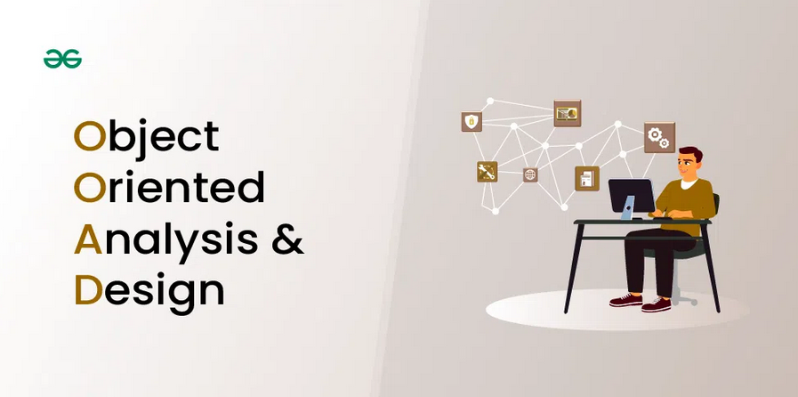
Part A: Object-Oriented Design
MODULE 2: OBJECT-ORIENTED MODELLING
Abu Saleh Musa Miah (PhD)
Notes:
Object-Oriented Analysis and Design: Good software design begins before coding. After establishing the initial software requirements, design practices involve two main activities: conceptual design and technical design, importance of design and object-oriented thinking, and how to design software using techniques like CRC cards.

Slide 2
Presentation Outline
Creating Models in Design
Major Design Principle

Slide 3
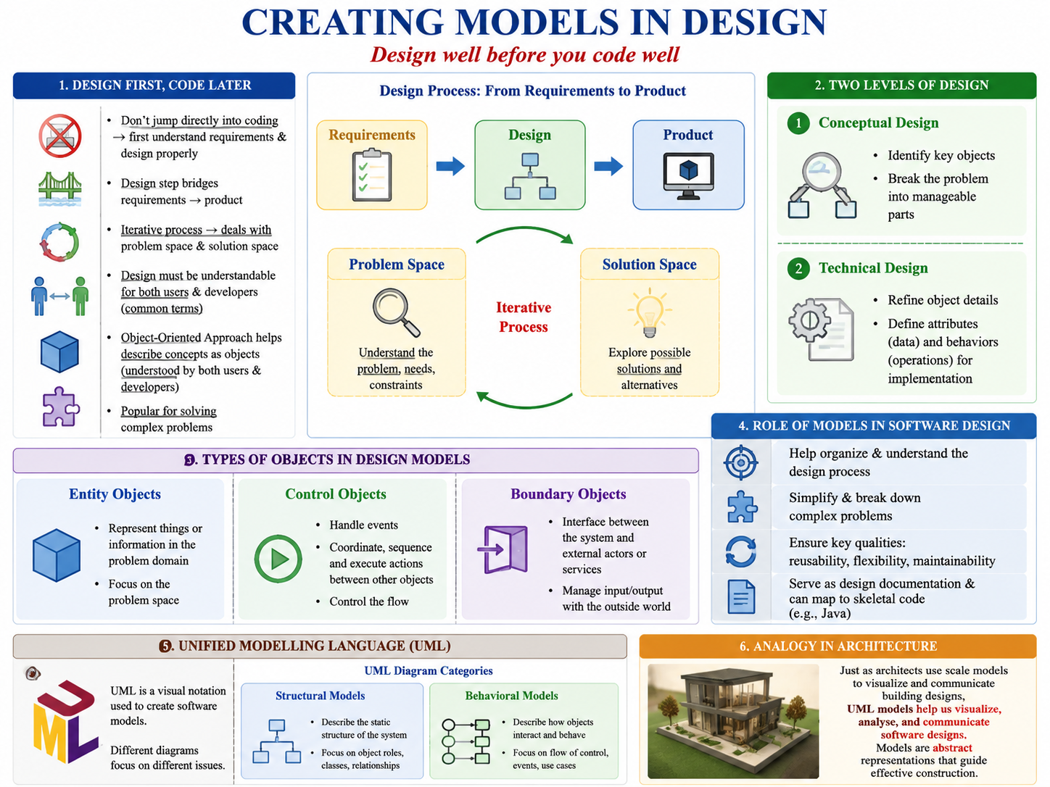


Creating Models in Design
Types of Objects in Design Models
  Entity Objects → focus on problem space
  Control Objects → handle events & coordinate actions
  Boundary Objects → connect system to outside services
Role of Models in Software Design
  Help organize & understand design process
  Simplify & break down complex problems
  Ensure qualities: reusability, flexibility, maintainability
  Serve as design documentation & can map to skeletal code (e.g., Java)
Unified Modelling Language (UML)
  Visual notation for software models
  Different UML diagrams focus on different issues:
    Structural Models → describe object roles & relationships
    Analogy: like a scale model in architecture

Slide 4
Creating Models in Design
Don’t jump directly into coding → first understand requirements & design properly
Design step bridges requirements → product
Iterative process → deals with problem space & solution space
Design must be understandable for both users & developers (common terms)
Object-Oriented Approach helps describe concepts as objects (understood by both users & developers)
Popular for solving complex problems
Two levels of design:
  Conceptual Design → identify key objects, break problem into parts
  Technical Design → refine object details (attributes & behaviors) for implementation

Slide 5
Creating Models in Design
Types of Objects in Design Models
  Entity Objects → focus on problem space
  Control Objects → handle events & coordinate actions
  Boundary Objects → connect system to outside services
Role of Models in Software Design
  Help organize & understand design process
  Simplify & break down complex problems
  Ensure qualities: reusability, flexibility, maintainability
  Serve as design documentation & can map to skeletal code (e.g., Java)
Unified Modelling Language (UML)
  Visual notation for software models
  Different UML diagrams focus on different issues:
    Structural Models → describe object roles & relationships
    Analogy: like a scale model in architecture

Slide 6
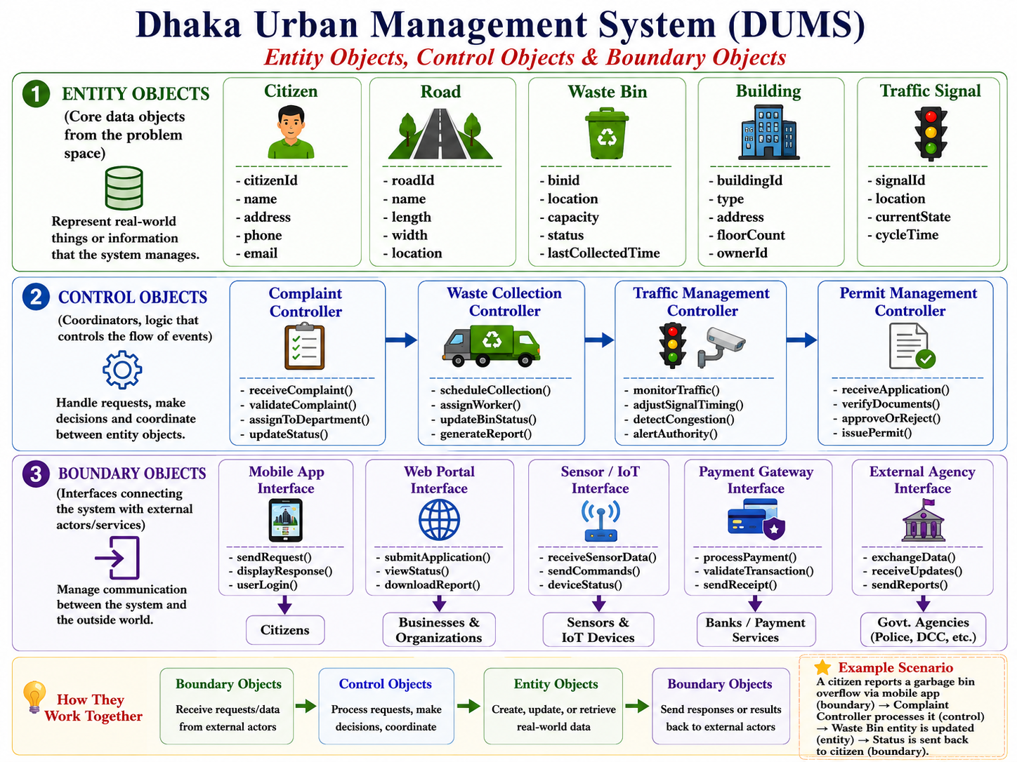
Creating Models in Design: Example
1. Entity Objects (core data objects from the problem space) DUMS
These represent things in the real world that your system needs to keep track of.
House Management → House, Resident, Water Bill, Electricity Bill, Maintenance Request
Garbage Management → GarbageBin, WasteTruck, CollectionSchedule, DumpingSite
Traffic Management → TrafficLight, Vehicle, RoadSegment, AccidentReport, CongestionLevel
Example: House(id, address, owner, status) or GarbageBin(id, location, capacity, lastCollectedTime)
2. Control Objects (coordinators, logic that controls the flow of events)
These objects process requests, make decisions, and coordinate between entity objects.
House Management → BillCalculator, MaintenanceManager,HouseAllocationController
Garbage Management → CollectionScheduler, RouteOptimizer, GarbageMonitoringController
Traffic Management → SignalController, TrafficFlowManager, EmergencyResponseCoordinator
Example: CollectionScheduler checks all GarbageBin fill levels and sends a task to a WasteTruck
3. Boundary Objects (interfaces connecting the system with external actors/services)
These are interaction points with users, devices, or external services.
House Management → ResidentAppUI, BillingPortal, SMSNotificationService
Garbage Management → TruckGPSInterface, IoT Sensor in GarbageBin, CitizenComplaintPortal
Traffic Management → DriverMobileApp, CCTV Feed Interface, PoliceDashboard, TrafficL.HI
💡 Example: A CitizenComplaintPortal lets residents report uncollected garbage, which is then sent to the CollectionScheduler.

Slide 7
Creating Models in Design: Example
1. Entity Objects (core data objects from the problem space) DUMS
These represent things in the real world that your system needs to keep track of.
House Management → House, Resident, Water Bill, Electricity Bill, Maintenance Request
Garbage Management → GarbageBin, WasteTruck, CollectionSchedule, DumpingSite
Traffic Management → TrafficLight, Vehicle, RoadSegment, AccidentReport, CongestionLevel
Example: House(id, address, owner, status) or GarbageBin(id, location, capacity, lastCollectedTime)
2. Control Objects (coordinators, logic that controls the flow of events)
These objects process requests, make decisions, and coordinate between entity objects.
House Management → BillCalculator, MaintenanceManager,HouseAllocationController
Garbage Management → CollectionScheduler, RouteOptimizer, GarbageMonitoringController
Traffic Management → SignalController, TrafficFlowManager, EmergencyResponseCoordinator
Example: CollectionScheduler checks all GarbageBin fill levels and sends a task to a WasteTruck
3. Boundary Objects (interfaces connecting the system with external actors/services)
These are interaction points with users, devices, or external services.
House Management → ResidentAppUI, BillingPortal, SMSNotificationService
Garbage Management → TruckGPSInterface, IoT Sensor in GarbageBin, CitizenComplaintPortal
Traffic Management → DriverMobileApp, CCTV Feed Interface, PoliceDashboard, TrafficL.HI
💡 Example: A CitizenComplaintPortal lets residents report uncollected garbage, which is then sent to the CollectionScheduler.

Slide 8
Creating Models in Design: Example
Iterative & Continuous Design
  First iteration: define entity objects like House, GarbageBin, TrafficLight.
  Next iteration: design control objects like BillCalculator, RouteOptimizer, SignalController to manage them.
  Then: refine boundary objects like mobile apps, web portals, and IoT sensors that connect the outside world to the system.
  This cycle continues — as Dhaka grows, new entities (e.g., metro stations), new control logic (e.g., AI-based traffic prediction), and new boundary services (e.g., chatbot for citizens) can be added.
1. Entity Objects (real-world data and resources in the farm) (AAS)
These represent things being managed in the farm:
Crop (type, growth stage, health status)
Soil (moisture level, pH, nutrient level)
IrrigationPump (status, capacity)
WeatherData (temperature, humidity, rainfall)
FertilizerTank (amount, type)
PestData (detection, severity)
💡 Example: SoilSensor(id, location, moisture, phLevel)

Slide 9
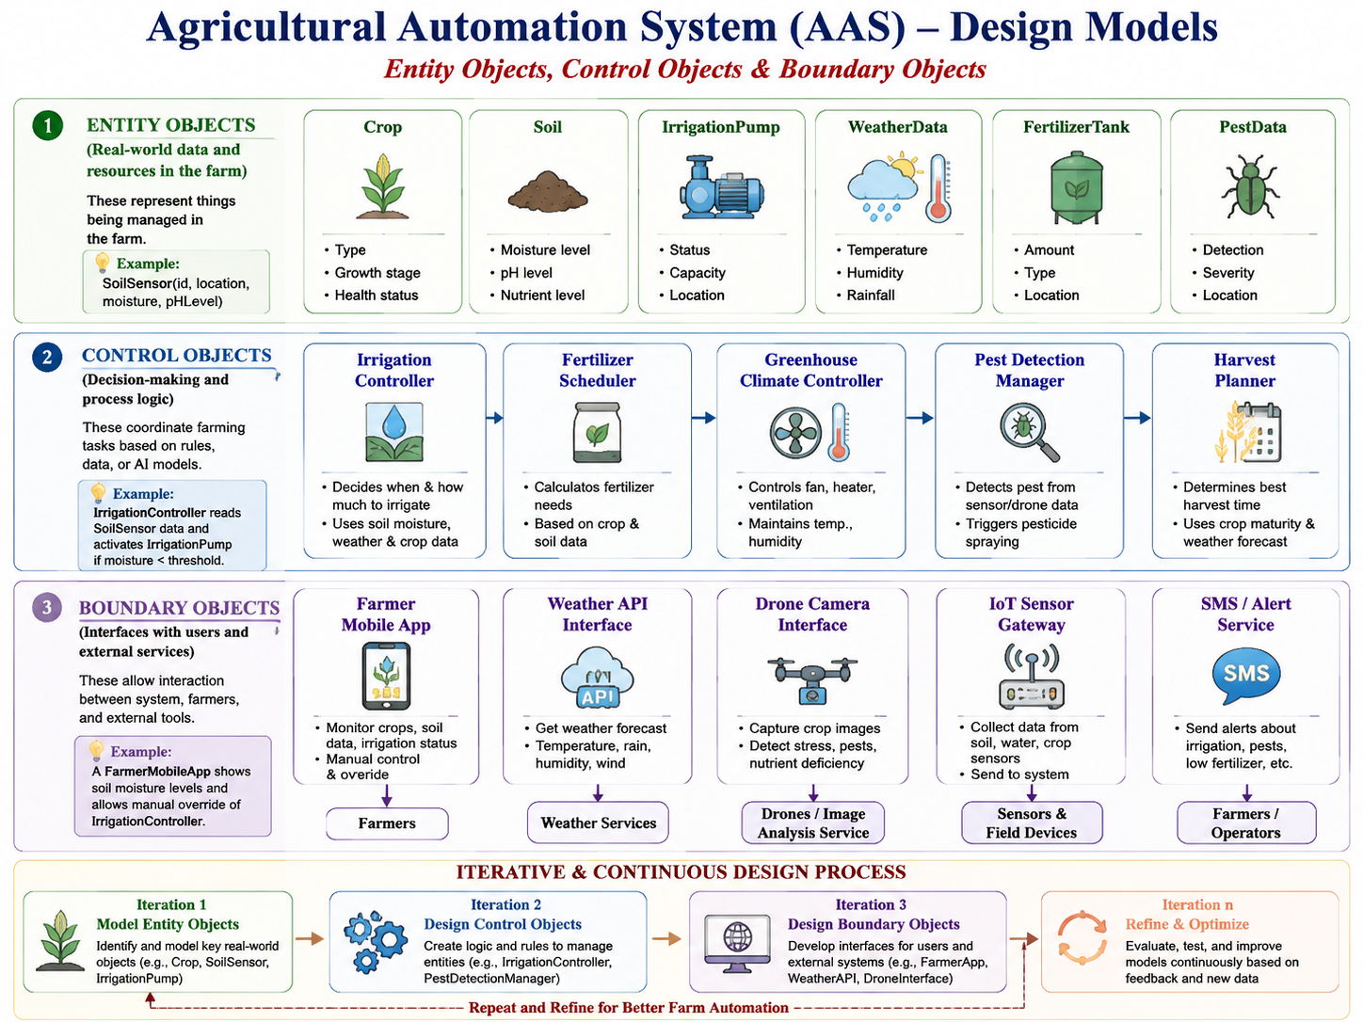
Creating Models in Design: Example
Iterative & Continuous Design
  First iteration: define entity objects like House, GarbageBin, TrafficLight.
  Next iteration: design control objects like BillCalculator, RouteOptimizer, SignalController to manage them.
  Then: refine boundary objects like mobile apps, web portals, and IoT sensors that connect the outside world to the system.
  This cycle continues — as Dhaka grows, new entities (e.g., metro stations), new control logic (e.g., AI-based traffic prediction), and new boundary services (e.g., chatbot for citizens) can be added.
1. Entity Objects (real-world data and resources in the farm) (AAS)
These represent things being managed in the farm:
Crop (type, growth stage, health status)
Soil (moisture level, pH, nutrient level)
IrrigationPump (status, capacity)
WeatherData (temperature, humidity, rainfall)
FertilizerTank (amount, type)
PestData (detection, severity)
💡 Example: SoilSensor(id, location, moisture, phLevel)

Slide 10
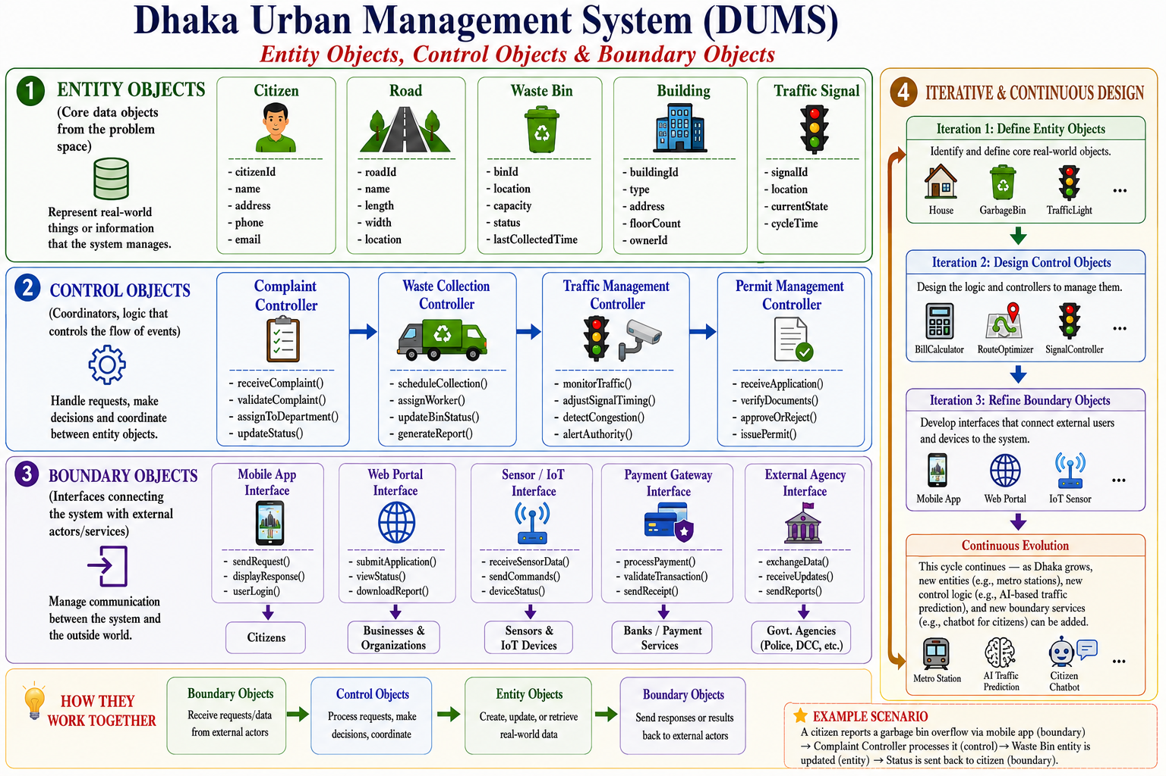
Creating Models in Design: Example
Iterative & Continuous Design
  First iteration: define entity objects like House, GarbageBin, TrafficLight.
  Next iteration: design control objects like BillCalculator, RouteOptimizer, SignalController to manage them.
  Then: refine boundary objects like mobile apps, web portals, and IoT sensors that connect the outside world to the system.
  This cycle continues — as Dhaka grows, new entities (e.g., metro stations), new control logic (e.g., AI-based traffic prediction), and new boundary services (e.g., chatbot for citizens) can be added.
1. Entity Objects (real-world data and resources in the farm) (AAS)
These represent things being managed in the farm:
Crop (type, growth stage, health status)
Soil (moisture level, pH, nutrient level)
IrrigationPump (status, capacity)
WeatherData (temperature, humidity, rainfall)
FertilizerTank (amount, type)
PestData (detection, severity)
💡 Example: SoilSensor(id, location, moisture, phLevel)

Slide 11
Creating Models in Design: Example
2. Control Objects (decision-making and process logic)
These coordinate farming tasks based on rules, data, or AI models:
IrrigationController → decides when and how much to irrigate crops
FertilizerScheduler → calculates fertilizer requirements based on crop and soil data
GreenhouseClimateController → controls fan, heater, and humidity
PestDetectionManager → triggers pesticide spraying if pest threshold is crossed
HarvestPlanner → determines best harvesting time based on crop maturity & weather forecast
💡 Example: IrrigationController reads SoilSensor data and activates IrrigationPump if moisture < threshold.
3. Boundary Objects (interfaces with users and external services)
These allow interaction between system, farmers, and external tools:
FarmerMobileApp → lets farmer monitor crops, soil data, and irrigation status
WeatherAPIInterface → gets weather forecasts from an external service
DroneCameraInterface → captures crop health images
IoTSensorGateway → collects data from soil, water, and crop sensors
SMS/AlertService → sends alerts about irrigation, pest outbreak, or low fertilizer
💡 Example: A FarmerMobileApp shows soil moisture levels and allows the farmer to manually override the IrrigationController.
(Iterative & Continuous Design)
First iteration: model entities (Crop, SoilSensor, IrrigationPump)
Next iteration: design control objects (IrrigationController, PestDetectionManager) to manage entities
Then: refine boundary objects (FarmerApp, DroneInterface, WeatherAPI) for user/system interaction
.
Notes:
Over time, the system evolves — e.g., adding AI yield prediction models (control), new disease detection sensors (entity), or a voice assistant for farmers (boundary)

Slide 12
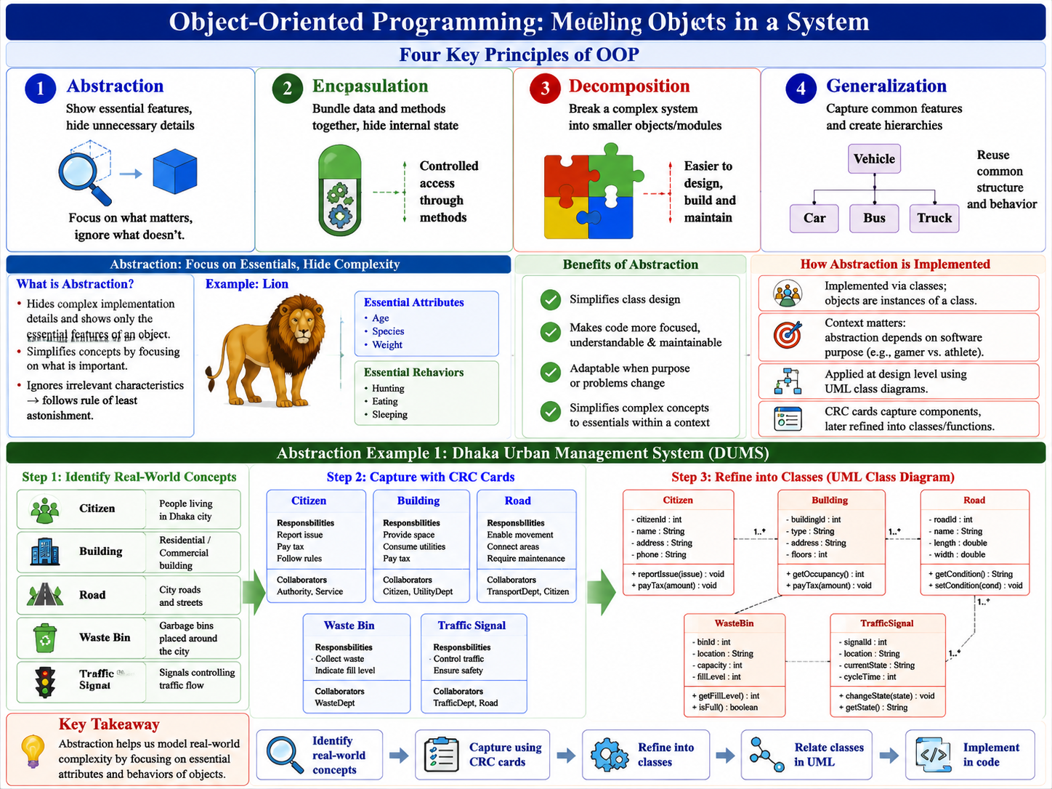
Notes:
A programming paradigm is a style of programming that defines how code is structured and how problems are solved. Different paradigms provide different ways of thinking: step-by-step (imperative), by describing results (declarative), with objects (OOP), with pure functions (functional), or with rules (logic). Meaning of Programming Paradigms
A programming paradigm is a style, approach, or way of thinking about how to write and organize computer programs.
It defines how problems are solved and how solutions are structured in code.
Different paradigms give different rules, concepts, and tools for:
How data is represented
How instructions are executed
How programs are structured (e.g., functions, objects, rules, flows)
Think of paradigms as “mindsets” or “philosophies” of programming. Just like in human languages, different paradigms offer different grammar and expressions to describe solutions.

Slide 13
Evolution of Programming Languages
Language = A system for communicating thoughts and ideas with each other.
System for communicating ideas (speaking, writing, gestures, etc.)
Languages must evolve to stay alive and useful
Programming languages evolve for:
  Solving new problems
  Offering more effective solutions
  Supporting new data structures
Evolution of ideas → shifts in programming paradigms
Top-Down Programming (Example)
  Design strategy for solving data-processing problems
  Maps processes → routines (starting from the “top”)
  Expressed as a tree of routines
  Implemented in languages supporting subroutines
Notes:
A programming paradigm is a style of programming that defines how code is structured and how problems are solved. Different paradigms provide different ways of thinking: step-by-step (imperative), by describing results (declarative), with objects (OOP), with pure functions (functional), or with rules (logic). Meaning of Programming Paradigms
A programming paradigm is a style, approach, or way of thinking about how to write and organize computer programs.
It defines how problems are solved and how solutions are structured in code.
Different paradigms give different rules, concepts, and tools for:
How data is represented
How instructions are executed
How programs are structured (e.g., functions, objects, rules, flows)
Think of paradigms as “mindsets” or “philosophies” of programming. Just like in human languages, different paradigms offer different grammar and expressions to describe solutions.

Slide 14
Evolution of Programming Languages
Why Study the History of Programming Paradigms?
  Older systems still use legacy languages & paradigms
  Object-oriented programming ≠ best solution for all problems
  New languages may:
    Expand on existing structures
    Modify older paradigms
  Understanding history helps:
    Recognize “old in new” paradigms
    Apply the most efficient paradigm for each problem
Notes:
A programming paradigm is a style of programming that defines how code is structured and how problems are solved. Different paradigms provide different ways of thinking: step-by-step (imperative), by describing results (declarative), with objects (OOP), with pure functions (functional), or with rules (logic). Meaning of Programming Paradigms
A programming paradigm is a style, approach, or way of thinking about how to write and organize computer programs.

Slide 15
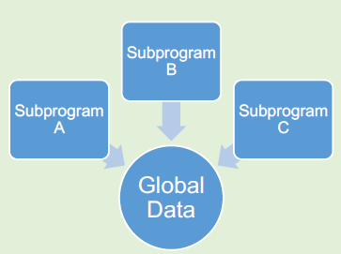
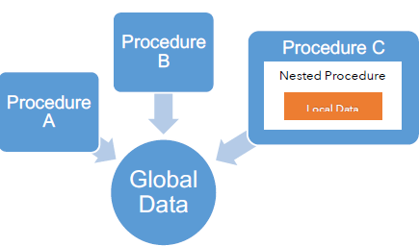
Evolution of Programming Languages
Programming Language and Time period | Solutions afforded by Programming Language | Uncontrolled global data changes cause unpredictable errors, highlighting the need for better data management.
COBOL Fortran 1960s | COBOL and Fortran employed a centralized global data model that stored information in a single shared memory location, reducing the overhead of passing individual copies through subroutines and enabling faster, more direct access on costly hardware. | Uncontrolled global data changes cause unpredictable errors, highlighting the need for better data management.
Algol 68 Pascal Early 1970s | Data Management in the 1960s Global data widely used → changes caused issues for subroutines Solution: Scopes & local variables → each subroutine/procedure had its own data. Abstract Data Types (ADT) Defined by programmer, not built into language | By the mid-1970s, cheaper computer processing and expensive human labor led to larger, more complex software, making single-file program maintenance difficult.

Slide 16
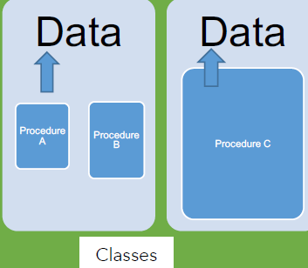
Evolution of Programming Languages
Programming Language and Time period | Solutions afforded by Programming Language | Uncontrolled global data changes cause unpredictable errors, highlighting the need for better data management.
Object- Oriented Programming (Java, C++, C#, etc.) 1980s to present | Rise of Object-Oriented Design Abstract data types improved program management, but no inheritance existed Object-oriented design emerged to solve this limitation Objectives of Object-Oriented Design: Simplify writing abstract data types Structure systems around classes (abstract data types) Enable inheritance → one data type can extend another | Object oriented programming is the predominant programming paradigm now.

Slide 17
Evolution of Programming Languages
1. COBOL (Business-oriented, verbose English-like, 1960s)
Designed for business data processing. DUMS Code looks like English.
01 BIN1 PIC 9(4) VALUE 120. *> can store numbers like 45, 9999, 0
01 BIN2 PIC 9(2) VALUE 12. *> can store up to 2 digits (00–99)
01 BIN3 PIC X(10) VALUE "Dhaka". *> X means alphanumeric, up to 10 chars
IDENTIFICATION DIVISION.
PROGRAM-ID. GARBAGE-MANAGEMENT.
DATA DIVISION.
WORKING-STORAGE SECTION.
01 BIN1 PIC 9(4) VALUE 120.
01 BIN2 PIC 9(4) VALUE 150.
01 BIN3 PIC 9(4) VALUE 100.
01 TOTAL PIC 9(5).
PROCEDURE DIVISION.
ADD BIN1 TO TOTAL.
ADD BIN2 TO TOTAL.
ADD BIN3 TO TOTAL.
DISPLAY "TOTAL GARBAGE COLLECTED: " TOTAL.
STOP RUN.
Notes:
PIC → short for PICTURE clause.
It describes the format, size, and type of a data item (field).
Think of it like a data type + length specifier.
9 → means a numeric digit (0–9).
Each 9 represents one digit position.
(4) → means repeat “9” four times → so the field can hold up to 4 digits.
Equivalent to writing 9999.
VALUE 120 → initializes the variable with the number 120.

Slide 18
Evolution of Programming Languages
2. ALGOL 68 (Algorithmic, structured programming).
begin
int bin1 := 120, bin2 := 150, bin3 := 100;
int total := bin1 + bin2 + bin3;
print(("TOTAL GARBAGE COLLECTED = ", total))
end
4. Pascal (Teaching/Struct Programming, early 1970s)
3. FORTRAN (Scientific/Engineering, 1950s–1960s)
program GarbageManagement;
var
bin1, bin2, bin3, total: integer;
begin
bin1 := 120;
bin2 := 150;
bin3 := 100;
total := bin1 + bin2 + bin3;
writeln('TOTAL GARBAGE COLLECTED = ', total);
end.
PROGRAM GARBAGE
INTEGER BIN1, BIN2, BIN3, TOTAL
BIN1 = 120
BIN2 = 150
BIN3 = 100
TOTAL = BIN1 + BIN2 + BIN3
PRINT *, 'TOTAL GARBAGE COLLECTED = ', TOTAL
END
Notes:
PIC → short for PICTURE clause.
It describes the format, size, and type of a data item (field).
Think of it like a data type + length specifier.
9 → means a numeric digit (0–9).
Each 9 represents one digit position.
(4) → means repeat “9” four times → so the field can hold up to 4 digits.
Equivalent to writing 9999.
VALUE 120 → initializes the variable with the number 120.

Slide 19
Evolution of Programming Languages
3. JAVA
class GarbageBin {
int weight;
GarbageBin(int w) { weight = w; }
}
public class DhakaUrbanSystem {
public static void main(String[] args) {
GarbageBin b1 = new GarbageBin(120);
GarbageBin b2 = new GarbageBin(150);
GarbageBin b3 = new GarbageBin(100);
int total = b1.weight + b2.weight + b3.weight;
System.out.println("TOTAL GARBAGE COLLECTED = " + total);
}
}
Notes:
PIC → short for PICTURE clause.
It describes the format, size, and type of a data item (field).
Think of it like a data type + length specifier.
9 → means a numeric digit (0–9).
Each 9 represents one digit position.
(4) → means repeat “9” four times → so the field can hold up to 4 digits.
Equivalent to writing 9999.
VALUE 120 → initializes the variable with the number 120.

Slide 20
Evolution of Programming Languages
COBOL → relies heavily on global data areas (like WORKING-STORAGE SECTION), which makes large projects difficult to manage (hard to avoid conflicts).
ALGOL 68 → introduced block structure with scopes (local vs global variables).
Java / OOP → solves the “global data” problem by encapsulation:
    Data is stored inside objects (classes)
    Only accessible through methods (controlled access)
    Prevents unwanted global data sharing
COBOL → everything is global (messy in big systems).
ALGOL 68 → introduced local scopes.
Java/OOP → goes further by encapsulating data inside classes and restricting access with modifiers

Slide 21
Evolution of Programming Languages
Example: Sum of 10 Numbers in Java (OOP Encapsulation)
class NumberSummer{
private int[] numbers; // data is private, not global
private int total; // Constructor initializes numbers
public NumberSummer(int[] nums) {
numbers = nums;
total = 0; } // Method to calculate sum
public int calculateSum() {
for (int n : numbers) {
total += n; }
return total; }}
public class Main {
public static void main(String[] args) {
int[] nums = {1,2,3,4,5,6,7,8,9,10};
NumberSummer summer = new NumberSummer(nums); System.out.println("Sum = " + summer.calculateSum());
}}

Slide 22
Four Major Design Principles in OOP
Object-oriented programming models objects in a system
Four key principles: Abstraction, Encapsulation, Decomposition, Generalization

Slide 23
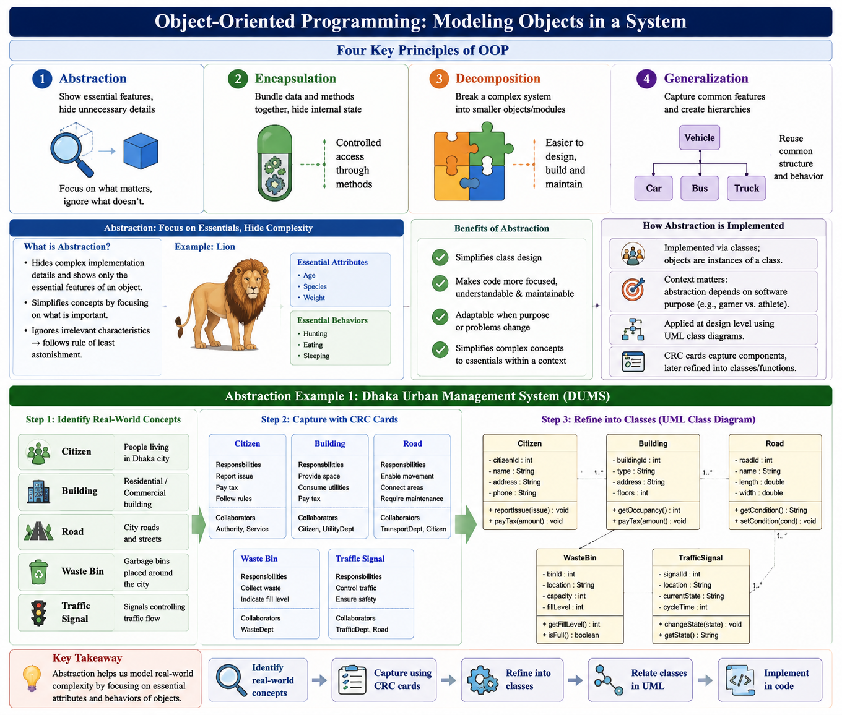
Four Major Design Principles in OOP
Object-oriented programming models objects in a system
Four key principles: Abstraction, Encapsulation, Decomposition, Generalization

Slide 24
Abstraction
Abstraction is the process of hiding complex implementation details and showing only the essential features of an object.
Simplifies complex concepts by focusing on essential details
Ignores irrelevant characteristics → follows rule of least astonishment
Implemented via classes; objects are instances of a class
Context matters: abstraction depends on software purpose (e.g., gamer vs. athlete)
Captures two main aspects:
  Basic attributes (e.g., age of a lion)
  Basic behaviors/responsibilities (e.g., hunting, eating, sleeping)
Benefits:
  Simplifies class design
  Makes code more focused, understandable, and maintainable
  Adaptable when system purpose or problem changes
Notes:
When you drive a car, you use the steering wheel, pedals, and gear shift (the interface). You don't need to know about the exact mechanics of the internal combustion engine, the hydraulic brake system, or the transmission (the implementation). The car abstracts these details away from you.
Software Example:
In our bookstore, we don't need to model every single possible attribute of a book. We abstract away irrelevant details for our specific context.
Without Abstraction: "A book is made of paper, glue, and ink, has a specific weight, was printed on a specific date at a specific factory, and has a slightly torn corner on page 43."
With Abstraction (for our system): A Book is defined by its ISBN, title, author, price, and quantityInStock. These are the essential attributes for managing an inventory and making sales.

Slide 25
Abstraction
Hiding complex reality while exposing only essentials
// Abstract class example
abstract class Vehicle { abstract void startEngine(); // Abstract method (no implementation)
public void honk() { // Concrete method
System.out.println("Beep beep!"); } }
class Car extends Vehicle { @Override void startEngine()
{ System.out.println("Car engine started with key"); } }
class ElectricCar extends Vehicle { @Override void startEngine()
{ System.out.println("Electric car started with button"); } }

Slide 26
Abstraction
Simplifies complex concepts to essentials within a context
Applied at the design level using UML class diagrams
CRC cards capture components, later refined into classes or functions
Each concept/class represented as a box with three sections:
  Class Name – same as Java class name
  Properties – equivalent to Java’s member variables
    Format: <variable name> : <variable type>
    Types can be classes or primitives
  Operations – equivalent to Java’s methods
    Format: <method>(<parameter list>) : <return type>
Mapping:
  Class Diagram → Java Class
  Properties → Member Variables
  Operations → Methods

Slide 27
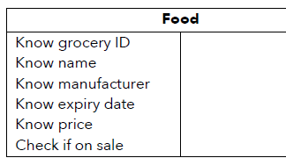
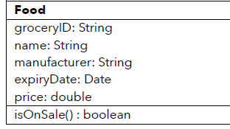
Abstraction
Example: Food Item (Grocery Store Context)
Class Name: Food
Properties: groceryID, name, manufacturer, expiryDate, price
Operation: isOnSale(date: Date): Boolean
  Returns true/false depending on sale status
CRC vs. Class Diagram
  CRC: lists responsibilities together
  Class Diagram: separates properties vs. operations
  Easier translation into code for programmers
Example: Variables
public class Food {
public String groceryID;
public String name;
public String manufacturer;
public Date expiryDate;
public double price;
public boolean isOnSale(Date date) {
// Implementation
}}
Example: Class Diagrams

Slide 28
Abstraction
Abstraction Example 1: Dhaka Urban Management System (DUMS)
Suppose we want to model Garbage Bins in DUMS: We don’t need to care about sensor chip design or truck engine details → we just need essential attributes and behaviors.
// Concrete class hides details of how collection works
class SmartGarbageBin extends GarbageBin {
@Override
void collectGarbage() {
currentLevel = 0; // reset after collection
System.out.println("Garbage collected at " + location);
}
@Override
boolean isFull() {
return currentLevel >= capacity;
}}
abstract class GarbageBin {
// Essential attributes
protected String location;
protected int capacity;
protected int currentLevel;
// Essential behaviors
abstract void collectGarbage();
abstract boolean isFull();
}
Abstraction here:
  Shows location, capacity, and basic behavior (collectGarbage, isFull).
  Hides how sensors detect fullness, how trucks are dispatched, how waste is processed.

Slide 29
Abstraction
Abstraction Example 2: Agricultural Automation System (AAS)
Suppose we want to model an Irrigation System.
// Abstract class for irrigation
abstract class IrrigationSystem {
protected String fieldId;
protected int waterLevel;
// Essential behaviors
abstract void irrigate();
abstract boolean needsIrrigation();
}
// Implementation hides details of pump operation
class SmartIrrigationSystem extends IrrigationSystem {
@Override
void irrigate() {
waterLevel = 100; // restore soil moisture
System.out.println("Field " + fieldId + " irrigated.");
}
@Override
boolean needsIrrigation() {
return waterLevel < 40; // below threshold
}
}
Abstraction here:
  Shows fieldId, waterLevel, irrigate, needsIrrigation.Hides how soil sensors measure moisture, how water is pumped, how scheduling is optimized..

Slide 30
Abstraction
Benefits in Both Systems
  Simplifies design → Developers think only about key features.
  Maintainability → If the garbage collection logic or pump mechanism changes, we don’t touch the abstraction.
  Adaptability → Can extend the system (e.g., add AI-based optimization) without changing high-level abstractions.
In DUMS, abstraction means thinking of GarbageBin with only essential features (location, capacity, collect).
In AAS, abstraction means thinking of IrrigationSystem with only essential features (field, water level, irrigate).

Slide 31
Abstraction Table: DUMS vs AAS
System | Object | Essential Attributes (What it is) | Essential Behaviors (What it does)
DUMS (Dhaka Urban Management System) | House | Address, Owner, Occupants, UtilityStatus | PayBill(), RequestMaintenance(), ReportIssue()
 | GarbageBin | Location, Capacity, CurrentLevel | collectGarbage(), isFull(), sendAlert()
 | TrafficLight | Location, SignalState (Red/Green/Yellow), Timer | changeSignal(), detectTrafficFlow(), alertEmergency()
AAS (Agricultural Automation System) | Soil | Location, MoistureLevel, pH, Nutrients | measureMoisture(), checkFertility()
 | Crop | Type, GrowthStage, HealthStatus | grow(), harvest(), detectDisease()
 | IrrigationSystem | FieldId, WaterLevel, Status | irrigate(), needsIrrigation(), scheduleWatering()

Slide 32
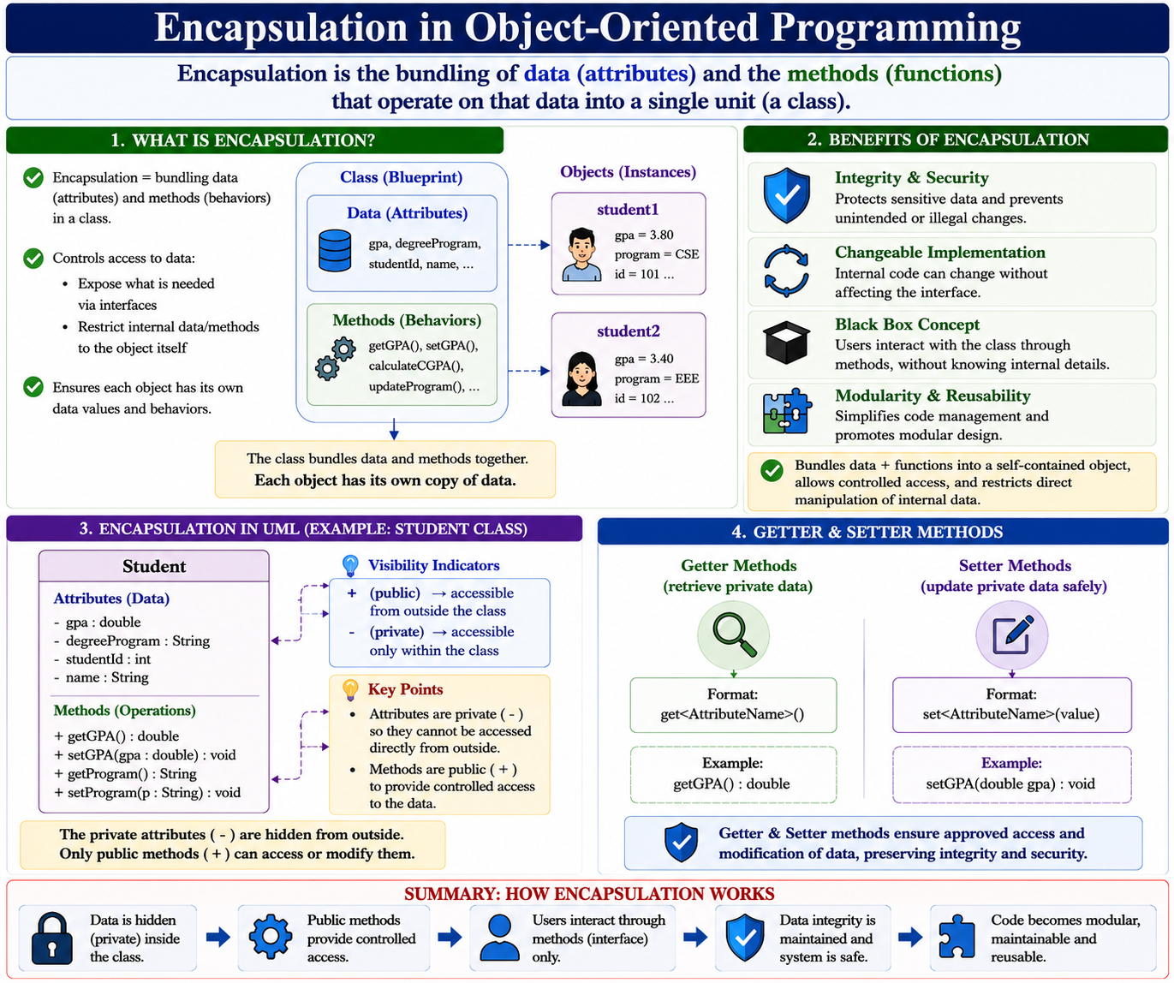
Encapsulation in Object-Oriented Programming
Encapsulation is the bundling of data (attributes) and the methods (functions) that operate on that data into a single unit (a class).
Encapsulation = bundling data (attributes) and methods (behaviors) in a class
Controls access to data:
  Expose what is needed via interfaces
  Restrict internal data/methods to the object itself
Ensures each object has its own data values and behaviors
Benefits of Encapsulation
  Integrity & Security protects sensitive data, prevents unintended changes
  Changeable Implementation: internal code can change without affecting the interface
  Black Box Concept: users interact with the class through methods, without knowing internal details
  Modularity & Reusability simplifies code management, promotes modular design
Notes:
More importantly, it restricts direct access to some of an object's components, which is a way of preventing accidental interference and misuse.
Real-World Analogy: A bank account. Your account balance (data) is bundled with operations like deposit() and withdraw() (methods).
We cannot directly change your balance; you must use the methods. The withdraw() method encapsulates the logic of checking if you have sufficient funds before updating the balance.
Software Example:
In our Book class, we don't want some other part of the program to directly change the price to a negative number. That would break our system. We encapsulate the price attribute and provide a controlled method to change it.

Slide 33
Encapsulation in Object-Oriented Programming
Encapsulation is the bundling of data (attributes) and the methods (functions) that operate on that data into a single unit (a class).
Encapsulation = bundling data (attributes) and methods (behaviors) in a class
Controls access to data:
  Expose what is needed via interfaces
  Restrict internal data/methods to the object itself
Ensures each object has its own data values and behaviors
Benefits of Encapsulation
  Integrity & Security protects sensitive data, prevents unintended changes
  Changeable Implementation: internal code can change without affecting the interface
  Black Box Concept: users interact with the class through methods, without knowing internal details
  Modularity & Reusability simplifies code management, promotes modular design
Notes:
More importantly, it restricts direct access to some of an object's components, which is a way of preventing accidental interference and misuse.
Real-World Analogy: A bank account. Your account balance (data) is bundled with operations like deposit() and withdraw() (methods).
We cannot directly change your balance; you must use the methods. The withdraw() method encapsulates the logic of checking if you have sufficient funds before updating the balance.
Software Example:
In our Book class, we don't want some other part of the program to directly change the price to a negative number. That would break our system. We encapsulate the price attribute and provide a controlled method to change it.

Slide 34
Encapsulation in Object-Oriented Programming UML
Bundles data + functions into a self-contained object
Allows controlled access to data and functions
Restricts direct manipulation of internal data
Expressed in UML class diagrams through attributes + methods
Encapsulation in UML:
  Class diagram bundles attributes & operations
  Visibility indicators:
    + (public) → accessible from outside the class
    - (private) → accessible only within the class
  Example: Student class
    Attributes: - gpa, - degreeProgram (private)
    Methods: + getGPA(), + setGPA() (public)
Benefits of Encapsulation
  Controls how data is accessed/modified
  Prevents unexpected direct changes
  Preserves data integrity
Notes:
More importantly, it restricts direct access to some of an object's components, which is a way of preventing accidental interference and misuse.
Real-World Analogy: A bank account. Your account balance (data) is bundled with operations like deposit() and withdraw() (methods).
We cannot directly change your balance; you must use the methods. The withdraw() method encapsulates the logic of checking if you have sufficient funds before updating the balance.
Software Example:
In our Book class, we don't want some other part of the program to directly change the price to a negative number. That would break our system. We encapsulate the price attribute and provide a controlled method to change it.

Slide 35
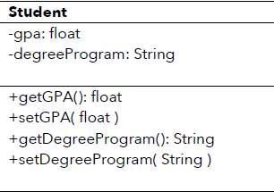
Encapsulation in Object-Oriented Programming UML
Getter & Setter Methods
  Getter methods: retrieve private data
    Format: get<AttributeName>()
    Example: getGPA()
  Setter methods: safely update private data
    Format: set<AttributeName>(value)
    Example: setGPA(double gpa)
  Ensure approved access & modification
Example: UML Class Diagram for Student
public class Student {
// Private attributes (hidden data)
private double gpa;
private String degreeProgram;
// Public methods (controlled access)
public double getGPA() {
return gpa; }
public void setGPA(double gpa) {
if (gpa >= 0 && gpa <= 4.0) { // validation
this.gpa = gpa;
}
}
}
Notes:
More importantly, it restricts direct access to some of an object's components, which is a way of preventing accidental interference and misuse.
Real-World Analogy: A bank account. Your account balance (data) is bundled with operations like deposit() and withdraw() (methods).
We cannot directly change your balance; you must use the methods. The withdraw() method encapsulates the logic of checking if you have sufficient funds before updating the balance.
Software Example:
In our Book class, we don't want some other part of the program to directly change the price to a negative number. That would break our system. We encapsulate the price attribute and provide a controlled method to change it.

Slide 36
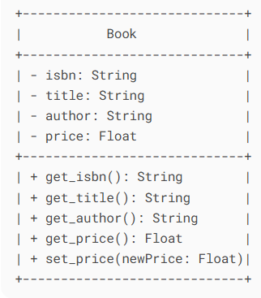
Encapsulation
UML Visualization:
The full class diagram shows methods and their visibility.
------------------------
| Student |
------------------------
| - gpa: double |
| - degreeProgram: String |
------------------------
| + getGPA(): double |
| + setGPA(gpa): void |
------------------------
The - denotes private (encapsulated) attributes, and + denotes public methods that form the interface.

Slide 37
Encapsulation: DUMS-Example 1: Garbage Collection
public void updateFillLevel(double level) {
if (level >= 0 && level <= 100) {
this.fillLevel = level;
}
}
public String getLocation() {
return location;
}
}
public class GarbageBin {
// Private attributes (hidden data)
private double fillLevel; // percentage (0–100)
private String location;
// Public methods (controlled access)
public double getFillLevel() {
return fillLevel;
}
Encapsulation role: Prevents outsiders from setting fillLevel to invalid values (e.g., >100%). Only controlled updates are allowed.

Slide 38
Encapsulation: DUMS-Example 2: Traffic Signal Management
public class TrafficSignal {
private String currentColor; // "Red", "Yellow", "Green"
private int timer; // seconds remaining
public String getCurrentColor() {
return currentColor;
}
public void changeSignal(String color) {
if (color.equals("Red") || color.equals("Yellow") || color.equals("Green")) {
this.currentColor = color;
}
}
}
Encapsulation role: Restricts invalid signals (e.g., "Blue"). Ensures system integrity in city traffic management.

Slide 39
Encapsulation: AAS-Example 1: Soil Sensor
public class SoilSensor {
private double moistureLevel; // %
private double pH; // soil pH value
public double getMoistureLevel() {
return moistureLevel;
}
public void setMoistureLevel(double level) {
if (level >= 0 && level <= 100) {
this.moistureLevel = level;
}
}
public double getPH() {
return pH;
}
public void setPH(double pH) {
if (pH >= 0 && pH <= 14) {
this.pH = pH;
}
}
}
Encapsulation role: Protects against invalid sensor values (e.g., negative moisture, impossible pH > 14).

Slide 40
Encapsulation: AAS-Example-2 Irrigation Pump
public class IrrigationPump {
private boolean isOn;
private int flowRate; // liters/minute
public void startPump() {
isOn = true;
}
public void stopPump() {
isOn = false;
}
public void setFlowRate(int rate) {
if (rate >= 0 && rate <= 100) {
this.flowRate = rate;
}
}
public boolean getPumpStatus() {
return isOn;
}
}
Encapsulation role: Prevents unsafe flow rates and provides safe on/off control.
In DUMS, encapsulation ensures public safety & system consistency (e.g., garbage bins, traffic signals).
In AAS, encapsulation ensures data integrity & safe automation (e.g., soil readings, irrigation controls).

Slide 41
Decomposition in Object-Oriented Design
Definition: Dividing a whole into smaller parts or combining parts to form a whole
Purpose: Break problems into manageable pieces, each with a specific responsibility
Relation to Classes: Each part can be represented by a class; the whole object relates to its part classes
Similarity to Abstraction: Focuses on essential characteristics of each part
Notes:
Building a house. We don't think of it as one monolithic object. You decompose it into subsystems: the foundation, the framing, the electrical system, the plumbing system, the roof. Each of these can be designed and worked on somewhat independently.
Software Example:Our "Online Bookstore" is not just a Book class. We need to decompose it into its core parts.
What are the main "things" in our system? Book, Customer, ShoppingCart, Order.
How do they relate? A Customer has a ShoppingCart. An Order contains Books

Slide 42
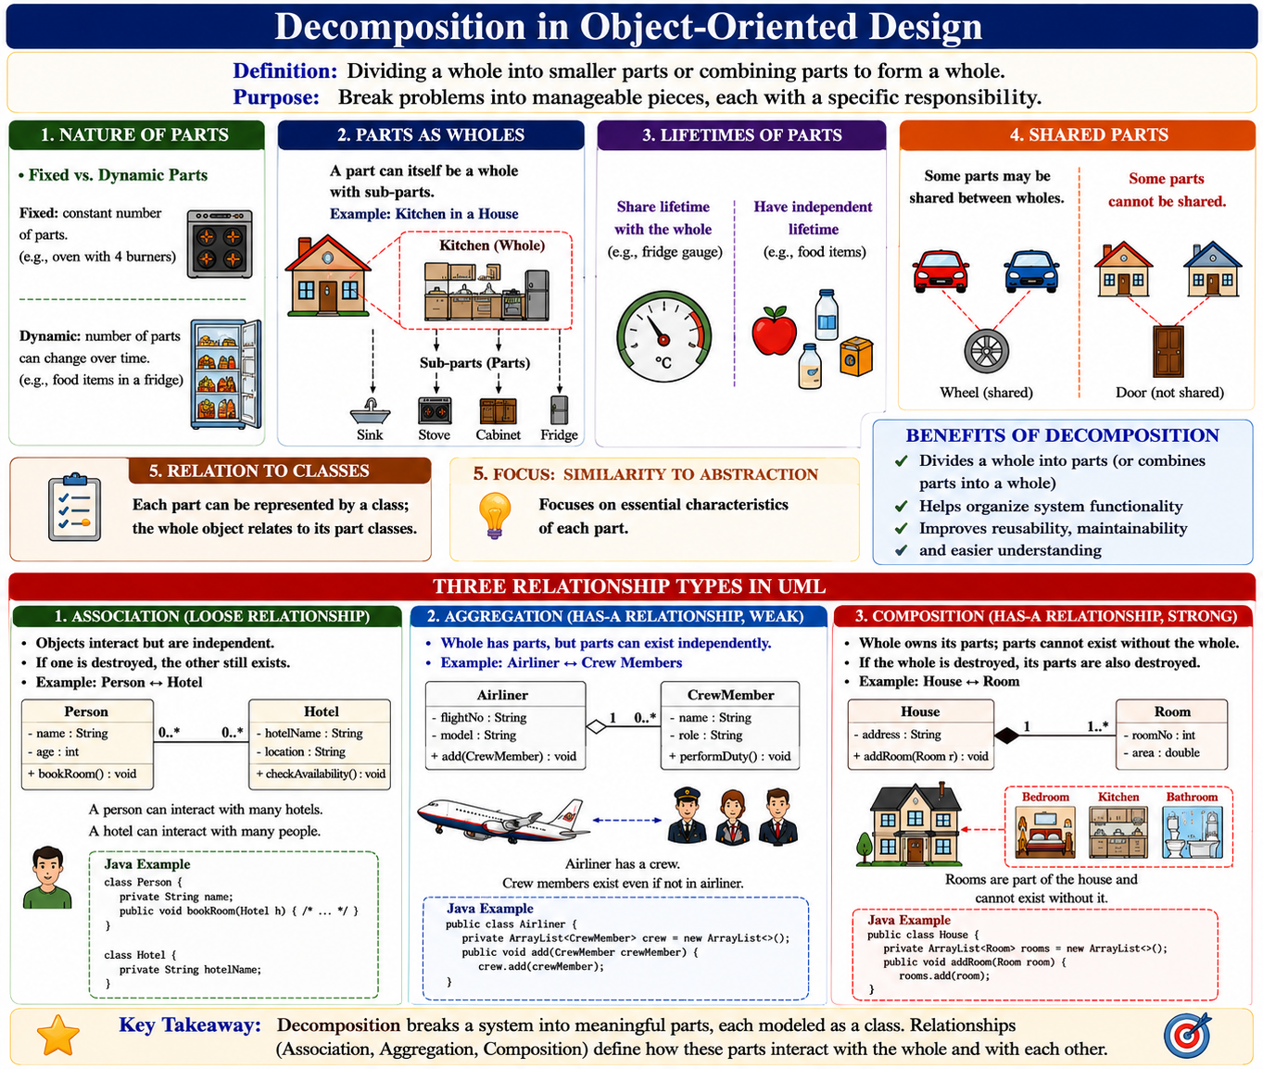
Decomposition in Object-Oriented Design
Definition: Dividing a whole into smaller parts or combining parts to form a whole
Purpose: Break problems into manageable pieces, each with a specific responsibility
Relation to Classes: Each part can be represented by a class; the whole object relates to its part classes
Similarity to Abstraction: Focuses on essential characteristics of each part
Notes:
Building a house. We don't think of it as one monolithic object. You decompose it into subsystems: the foundation, the framing, the electrical system, the plumbing system, the roof. Each of these can be designed and worked on somewhat independently.
Software Example:Our "Online Bookstore" is not just a Book class. We need to decompose it into its core parts.
What are the main "things" in our system? Book, Customer, ShoppingCart, Order.
How do they relate? A Customer has a ShoppingCart. An Order contains Books

Slide 43
Decomposition in Object-Oriented Design
Nature of Parts
Fixed vs. Dynamic Parts:
  Fixed: constant number of parts (e.g., oven with 4 burners)
  Dynamic: number of parts can change over time (e.g., food items in a fridge)
Parts as Wholes: A part can itself be a whole with sub-parts (e.g., kitchen in a house)
Lifetimes:
  Some parts share lifetime with the whole (e.g., fridge gauge)
  Some parts have independent lifetimes (e.g., food items)
Shared Parts: Some parts may be shared between wholes; others cannot
Notes:
Building a house. We don't think of it as one monolithic object. You decompose it into subsystems: the foundation, the framing, the electrical system, the plumbing system, the roof. Each of these can be designed and worked on somewhat independently.
Software Example:Our "Online Bookstore" is not just a Book class. We need to decompose it into its core parts.
What are the main "things" in our system? Book, Customer, ShoppingCart, Order.
How do they relate? A Customer has a ShoppingCart. An Order contains Books

Slide 44
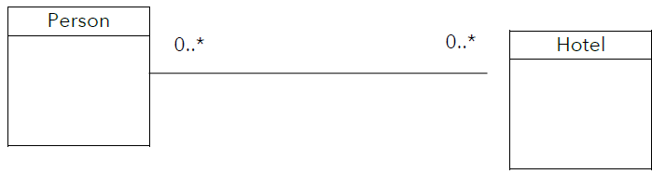
Decomposition in Design
Divides a whole into parts (or combines parts into a whole)
Helps organize system functionality
Three relationship types in UML:
  Association
  Aggregation
  Composition
Association (Loose Relationship)
Objects interact but are independent
If one is destroyed, the other still exists
Example: Person ↔ Hotel
  A person can interact with many hotels
  A hotel can interact with many people
UML: straight line with 0..* multiplicity
Java Example:
public class Student {
public void play(Sport sport) {
execute.play(sport);
}
}
Example: Student and Sport: separate, but loosely connected

Slide 45
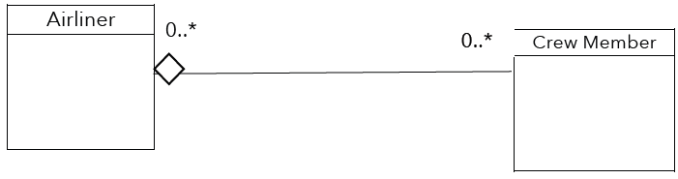
Decomposition in Design
Aggregation (Has-a Relationship, Weak)
  Whole has parts, but parts can exist independently
  Example: Airliner ↔ Crew Members
    Airliner has a crew
    Crew members exist even if not in airliner
  UML: empty diamond (◊) at the whole
  Java Example:
public class Airliner {
private ArrayList<CrewMember> crew = new ArrayList<>();
public void add(CrewMember crewMember) {
crew.add(crewMember);
}
}
Example: Airliner can have zero or more crew members

Slide 46
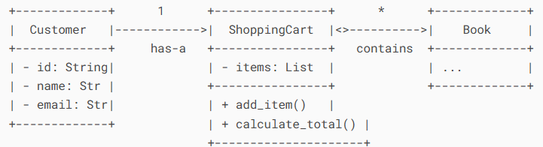
Decomposition
UML Visualization (Class Diagram with Relationships):
This shows the decomposed classes and their relationships.
The diagram uses association (has-a), aggregation (<>), and multiplicities (1, *) to show how the decomposed parts relate.

Slide 47
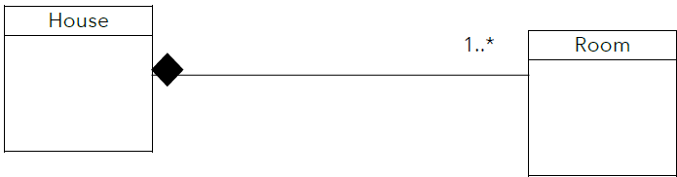
Composition (Strong Has-a Relationship)
Composition (Strong Has-a Relationship)
  Exclusive containment of parts (strongest form of decomposition)
  Whole cannot exist without its parts
  If whole is destroyed → parts are destroyed too
  Parts are tightly bound and accessed only through the whole
Example: House ↔ Room
  A House is made up of Rooms
  If the House is removed, Rooms no longer exist
  UML: filled diamond (◆) at the whole (House)
  Multiplicity: 1..* (House must have one or more Rooms)
Example:
public class House {
private Room room;
public House() {
room = new Room();
}
}
Room object created when House is created
Room cannot exist independently → tightly coupled
Example: Composition can be represented with a filled-in diamond using UML class diagrams.

Slide 48
Generalization (Inheritance)
Purpose: Reduces redundancy by capturing shared characteristics in a parent class (superclass)
Mechanism:
  Inheritance allows child classes (subclasses) to reuse attributes and behaviors from parent classes
  Child classes can add specialized attributes or behaviors
Benefits:
  Saves time and prevents errors
  Makes software more flexible, maintainable, and reusable
  Changes in common code only need to be made in the superclass
  Supports easy expansion of software with new subclasses
Notes:
Generalization is the process of extracting common characteristics from two or more classes and combining them into a generalized superclass. This is implemented in code through Inheritance, allowing a subclass (child) to inherit attributes and methods from a superclass (parent).
The concept of a "Vehicle." Cars, motorcycles, and trucks are all specific types of vehicles. They all share general properties like make, model, year, and start(). Instead of defining these properties for every type, we define them once in a general Vehicle class and have Car etc. inherit from it.
Software Example:
In our bookstore, we might sell more than just physical books. We might also sell e-books and audiobooks. These are all "products," but they have slight differences.
What do they have in common? product_id, title, author, price.
What is different? A physical book has weight and shipping_cost. An e-book has download_link and file_size.

Slide 49
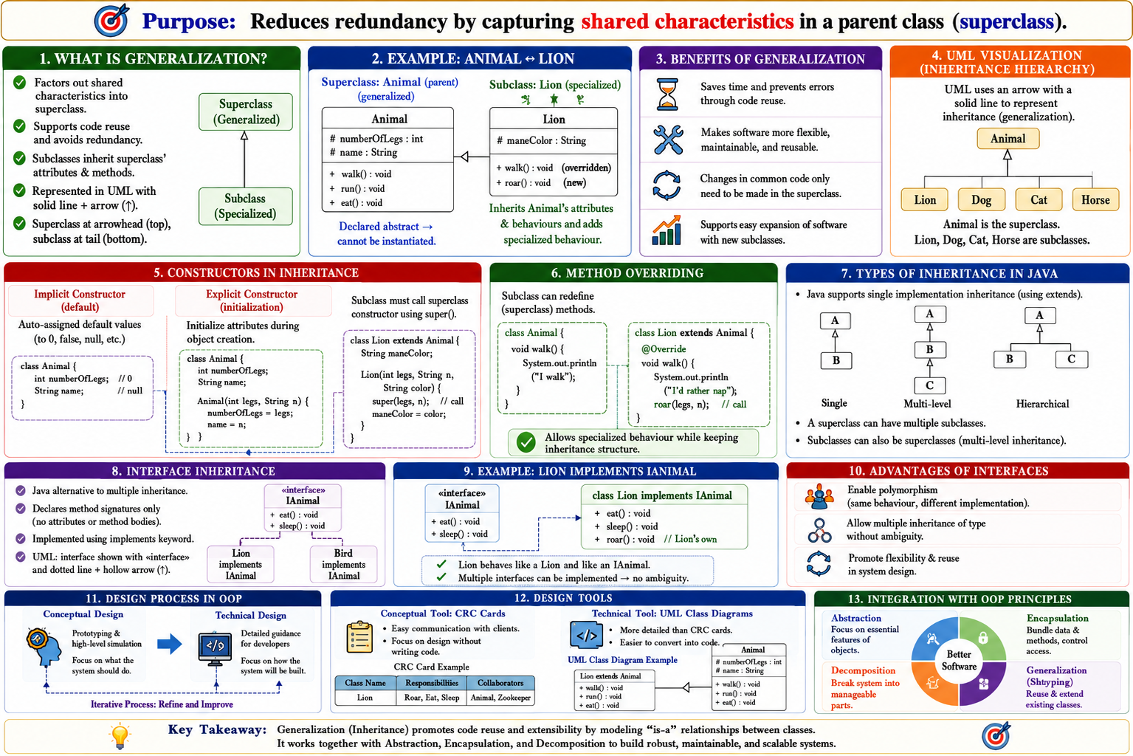
Generalization (Inheritance)
Purpose: Reduces redundancy by capturing shared characteristics in a parent class (superclass)
Mechanism:
  Inheritance allows child classes (subclasses) to reuse attributes and behaviors from parent classes
  Child classes can add specialized attributes or behaviors
Benefits:
  Saves time and prevents errors
  Makes software more flexible, maintainable, and reusable
  Changes in common code only need to be made in the superclass
  Supports easy expansion of software with new subclasses
Notes:
Generalization is the process of extracting common characteristics from two or more classes and combining them into a generalized superclass. This is implemented in code through Inheritance, allowing a subclass (child) to inherit attributes and methods from a superclass (parent).
The concept of a "Vehicle." Cars, motorcycles, and trucks are all specific types of vehicles. They all share general properties like make, model, year, and start(). Instead of defining these properties for every type, we define them once in a general Vehicle class and have Car etc. inherit from it.
Software Example:
In our bookstore, we might sell more than just physical books. We might also sell e-books and audiobooks. These are all "products," but they have slight differences.
What do they have in common? product_id, title, author, price.
What is different? A physical book has weight and shipping_cost. An e-book has download_link and file_size.

Slide 50
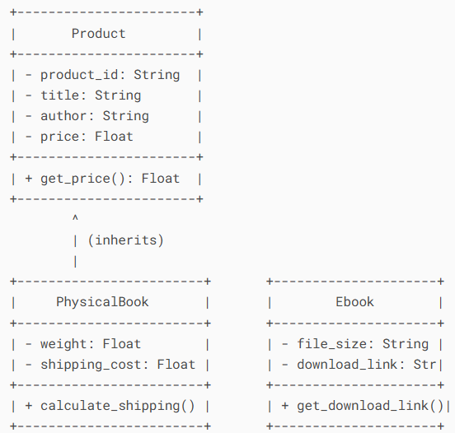
Generalization (Inheritance)
UML Visualization (Inheritance Hierarchy):
UML uses an arrow with a solid line to represent inheritance (generalization).

Slide 51
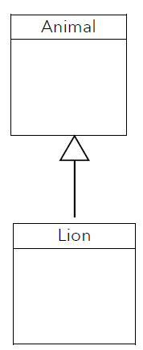
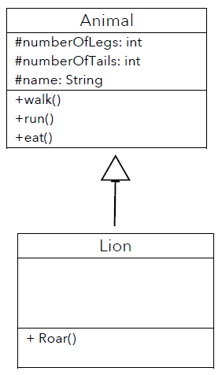
Generalization (Inheritance)
Factors out shared characteristics into a superclass
Supports code reuse and avoids redundancy
Subclasses inherit superclass’ attributes & methods
Represented in UML with solid line + arrow (↑)
  Superclass at arrowhead (top)
  Subclass at tail (bottom)
Example: Animal ↔ Lion
Superclass: Animal (generalized)
  Attributes: #numberOfLegs, #name, etc.
  Methods: walk(), run(), eat()
  Declared abstract → cannot be instantiated
Subclass: Lion (specialized)
  Inherits Animal’s attributes & behaviours
  Adds specialized behaviour → roar()

Slide 52
Generalization (Inheritance)
Constructors in Inheritance
  Implicit constructor: auto-assigned defaults (0, null)
  Explicit constructor: initialize attributes during object creation
  Subclass must call superclass constructor using super()
Method Overriding
  Subclass can redefine superclass methods
  Example:
  public void walk() {
  System.out.println("I'd rather nap"); } Allows specialized behaviour while keeping inheritance structure
Types of Inheritance in Java
  Single implementation inheritance only (using extends)
  A superclass can have multiple subclasses
  Subclasses can also be superclasses (multi-level inheritance)

Slide 53
Generalization (Inheritance)
Interface Inheritance
  Java alternative to multiple inheritance
  Declares method signatures only (no attributes or bodies)
  Implemented using implements keyword
  UML: interface shown with «interface» + dotted arrow (↑)
public interface IAnimal {
void move();
void speak();
void eat();
}
public class Lion implements IAnimal {
public void move() { … }
public void speak() { System.out.println("Roar!"); }
public void eat() { … }
}
Lion behaves like a Lion and like an IAnimal
Multiple interfaces can be implemented → no ambiguity
Advantages of Interfaces
  Enable polymorphism (same behaviour, different implementation)
  Allow multiple inheritance of type without ambiguity
  Promote flexibility & reuse in system design
Example: Animal Inheritance

Slide 54
Design Structure in Java and UML Class Diagrams
Design Process:
  Conceptual design → prototyping & high-level simulation
  Technical design → detailed guidance for developers
Conceptual Tools:
  CRC cards → easy communication with clients, focus on design without code
Technical Tools:
  UML Class Diagrams → more detailed than CRC cards, easier conversion to code
Integration with OOP Principles:
  Abstraction, Encapsulation, Decomposition, Generalization applied in Java and UML

Slide 55
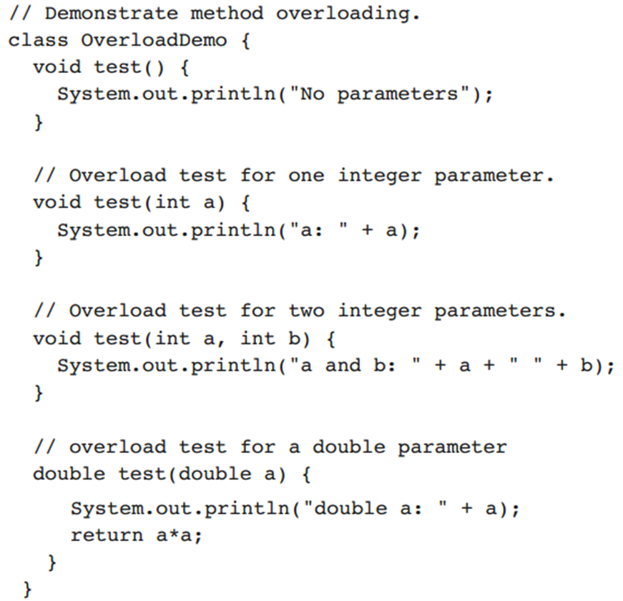
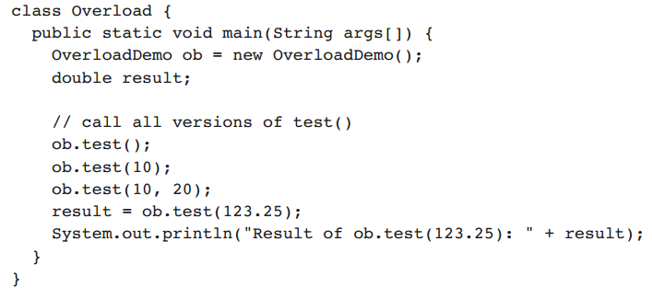
Example

Slide 56
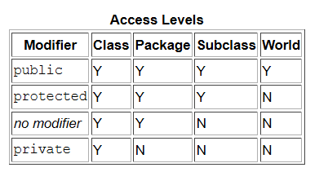
Access Control
Java’s access specifiers are public, private, and protected
Java also defines a default access level

Slide 57
Thank You Q/A

